Slide 1
Linear regression
Let’s keep it simple.

Slide 2
Machine Learning
A computer program is said to learn from experience E with respect to some class of tasks T and a performance measure P if it improves performance on T (according to P) with more E.
Standard programming
Machine Learning
Data
Computer
Data
Computer
Output
Program
Program
Output

Slide 3
Types of Learning
Supervised (inductive) Learning
Training data includes desired outputs
Unsupervised learning
Training data does not include desired outputs
Semi-supervised learning
Training data includes a few desired outputs
Reinforcement Learning
Rewards from sequence of actions.

Slide 4
Supervised Learning
Given : Training examples <x, f(x)> for some unknown function f.
Find : A good approximation to f.
Examples : 1. Credit risk assessment x : Properties of customer and proposed purchase. f(x) : Approve purchase or not.
2. Face recognition x : Bitmap picture of person’s face. f(x) :Name of the person..
Notes:
More examples : Disease diagnosis, automatic steering, situations where there is no human expert (Bond graph for a new molecule and we are predicting binding strength to AIDS protease molecule)

Slide 5
Terminology
Training example : An example / object / instance of the form (x,y)
Target function (target concept) : The true function f.
Hypothesis : A proposed function h believed to be similar to f.
Concept : A boolean function. Examples of which f(x) = 1 are called positive examples / instances and f(x) = 0 are called negative examples / instances
Features : the set of attributes, often represented as a vector, associated to an example, e.g., height and weight for gender prediction.

Slide 6
Terminology (contd.)
Labels : The possible values f(x) ϵ {1,2,...,K} are called classes or class labels. In classification, these are categories, while in regression they are real-values numbers.
Training Data : Data used for training the algorithm
Test Data : Data used exclusively for testing the algorithm
Validation Data : Data that is used to make the model better on the unseen data without using the test data. Once can bypass this data for smaller / problems involving less complex data.

Slide 7
Why Linear Regression?
Assumption of linear relationship -- simplest non-trivial relationship
Many relationships, even if nonlinear, are locally linear in range of interest
Variables can often be transformed in such a way to make the relationship linear
Relationships between predictors and response are very easy to interpret – useful for inference

Slide 8
Supervised learning problem
Living Area (feet²) | Price (1000$s)
2104 | 400
1600 | 330
2400 | 369
... | ...

Slide 9
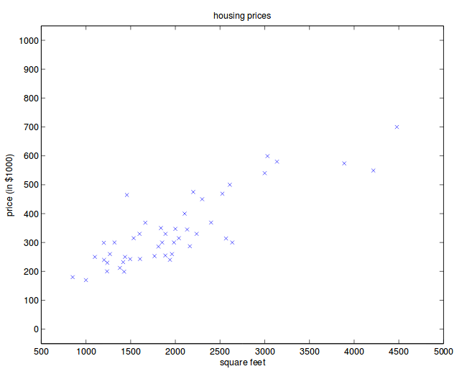
Supervised learning problem
x^{(i)} = input variable/feature (living area)
y^{(i)} = output/target
(x^{(i)},y^{(i)}) = training example
A list of m such training examples is called training dataset.

Slide 10
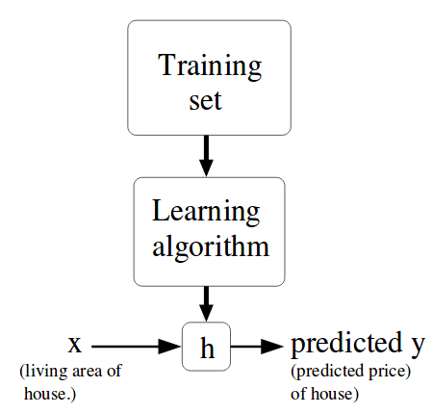
Hypothesis
Given a training set, to learn a function h: χ→Υ so that h(x) is a “good” predictor for the corresponding value of y.
h is called hypothesis for historical reasons.
When the target variable that we’re trying to predict is continuous, in our case price, we will call the learning algorithm as regression.
When the target variable (y) takes discrete values, we will call the learning algorithm as classification.

Slide 11
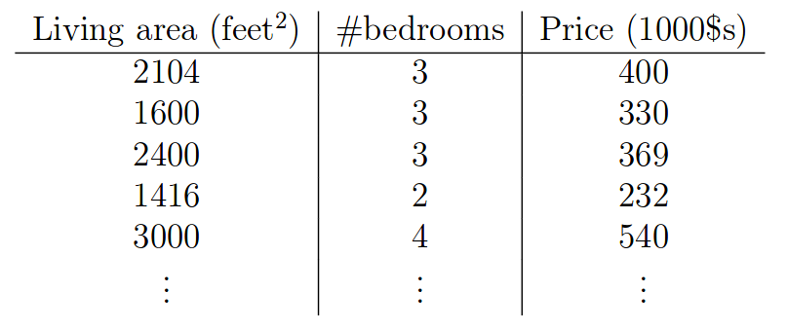


Example
Only 2 features, so our space is limited to R²
x₁^{(i)} : living area of i^{th} house
x₂^{(i)} : #bedrooms of i^{th} house
hypothesis :
Θi s are the weights/parameters

Slide 12

Cost function
Why ½
Have you seen anything similar?
Ordinary least squares regression ?
Solution to least squares solves this problem.

Slide 13
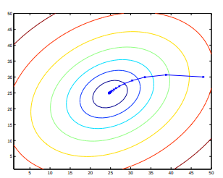
Gradient Descent method
Let’s have a function f : |R^{n} → |R, convex and differentiable, want to solve
min f(x) xϵ|R^{n} i.e. find x* such that f(x*) = min f(x)
Gradient descent : choose initial x⁽⁰⁾ ϵ |R^{n}, repeat :
x^{(k)} = x^{(k-1)} - t_{k}.∇f(x^{(k-1)}), k = 1, 2, 3, …
Stop at some point.

Slide 14

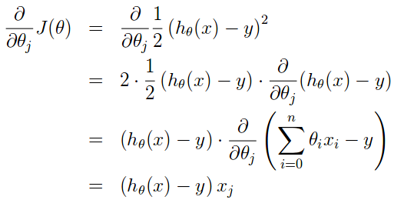

Solution : Least Mean Squares
We want to find out value of Θ so as to minimize J(Θ)
Let’s consider Gradient descent,
Now we know that,
Repeat until convergence,

Slide 15
Advantages and Disadvantages
Advantages: – Simple model – Interpretable coefficients – Can obtain good results with small data sets – Many variations/extensions
Disadvantages: – Model may be too simple to make accurate predictions over large range of values – Poor extrapolation – Sensitive to outliers in data – least squares error

Slide 16
Questions?

Slide 17
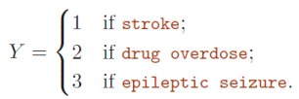
Mini Quiz
We want to predict a patient’s medical condition based on symptoms.*
– Suppose we code the three possible diagnoses as follows and use linear regression (ignoring the fact that Y is discrete-values) to build prediction model
Q : Do you think this a good approach? Why? What are the flaws with using this method for predicting a qualitative response?

Slide 18

Possible Arguments
Encoding outcomes creates an arbitrary ordering
Linear model (and thus prediction results) depend on this ordering, via least squares penalty
Coding qualitative responses may be reasonable if categories have natural ordering: e.g. “mild”, “moderate” and “severe”
For binary response (two classes), method not sensitive to choice of coding
Can use threshold on response to make predictions
Responses may not fall within [0, 1] interval, and can’t be interpreted as probabilities of belonging to a particular class

Slide 19
Logistic Regression
Because simplicity does not work always.

Slide 20
Logistic Regression
It’s not regression! It’s a classifier.
Logistic regression : binary classifier
Examples :
a) Email : spam/not spam
b) Online Transactions fraudulent : Yes/No
c) Tumor : malignant /benign
Output : y belongs to {0,1}, where 0 represents negative class (absence of something) and 1 represents positive class (presence of something).

Slide 21
(Yes) 1
Malignant?
(No) 0
Tumor size
Notes:
If you would like to make a hypothesis function it will look like something that passes like straight line between the points. Draw a line across the data points similar to y=x
Using thresholding, and if hypothesis function is greater than 0.5, then predict 1 and lesser than 0.5, then predict 0. Looks like linear regression works well for classifiction.
Let’s add a data point.

Slide 22
(Yes) 1
Malignant?
(No) 0
Tumor size
Notes:
Having this example changed linear regression to give worse hypothesis : Hence, linear regression is not a good idea for classification.

Slide 23
Why logistic regression?
One more reason why linear regression is a bad idea for classification :
In classification, y=0 or y=1, however h_{Θ}(x) <0 or h_{Θ}(x) >1
Hence, we will develop an algorithm “Logistic regression” where 0 <= h_{Θ}(x) <= 1

Slide 24
Logistic Regression Model
In Linear regression, the hypothesis was defined as ,
h_{Θ}(x) = Θ^{T}x
For Logistic regression, we will make a minor change as,
h_{Θ}(x) = g(Θ^{T}x),
Where g(z) = 1/(1+e^{-z}) : sigmoid function/logistic function.

Slide 25
Interpretation of the model
h_{Θ}(x) = estimated probability that y=1 on input x.
Mathematically,
P(y=1|x;Θ) = probability that y=1, given x; parameterized by Θ
Also,
P(y=1|x;Θ) + P(y=0|x;Θ) = 1 ⇒ P(y=0|x;Θ) = 1 - P(y=1|x;Θ)
Notes:
So, if we know the hypothesis, then we can also calculate probablity that y=0, given x and theta.

Slide 26

The problem statement
Training set : {(x⁽¹⁾, y⁽¹⁾), (x⁽²⁾, y⁽²⁾), (x⁽³⁾, y⁽³⁾), . . . , (x^{(m)}, y^{(m)})}
m-examples x ϵ and y ϵ {0, 1}
Q : How to choose the parameters Θ?
x₀
x₁
.
.
x_{n}

Slide 27
Logistic Regression Cost function
Can’t simply use squared loss as in linear regression:
Using the logistic regression model
results in a non-convex optimization.

Slide 28
Maximum Likelihood Estimation (MLE)
In statistics, maximum likelihood estimation (MLE) is a method of estimating the parameters of a statistical model, given observations. MLE attempts to find the parameter values that maximize the likelihood function, given the observations. The resulting estimate is called a maximum likelihood estimate, which is also abbreviated as MLE.
Suppose we are interested in the heights of adult female penguins, but are unable to measure the height of every penguin in a population (due to cost or time constraints). Assuming that the heights are normally distributed with some unknown mean and variance, the mean and variance can be estimated with MLE while only knowing the heights of some sample of the overall population
In mathematical sense, it is easier to deal with log likelihood than likelihood, so you will see that often.

Slide 29
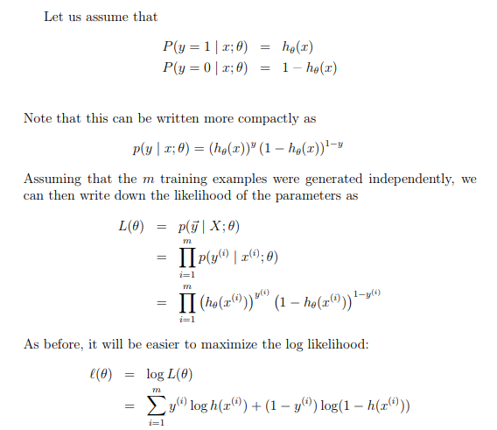
Slide courtesy : Andrew Ng’s notes : http://cs229.stanford.edu/notes/cs229-notes1.pdf

Slide 30
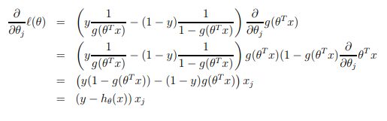

On differentiating with respect to the parameters, we get
This therefore gives us the stochastic ascent rule as,
Voila, Exactly the same as seen in Linear Regression !
Slide courtesy : Eric Keaton, https://www.cc.gatech.edu/~bboots3/CS4641-Fall2016/Lectures/Lecture6.pdf

Slide 31
Multi-class classification
If only things were binary in this universe.

Slide 32
Multi-class classification Examples
Email foldering/tagging : Friends, family, work, hobby
Medical Diagnosis : Not ill, cold, flu
Weather : sunny, cloudy, rainy, snow

Slide 33
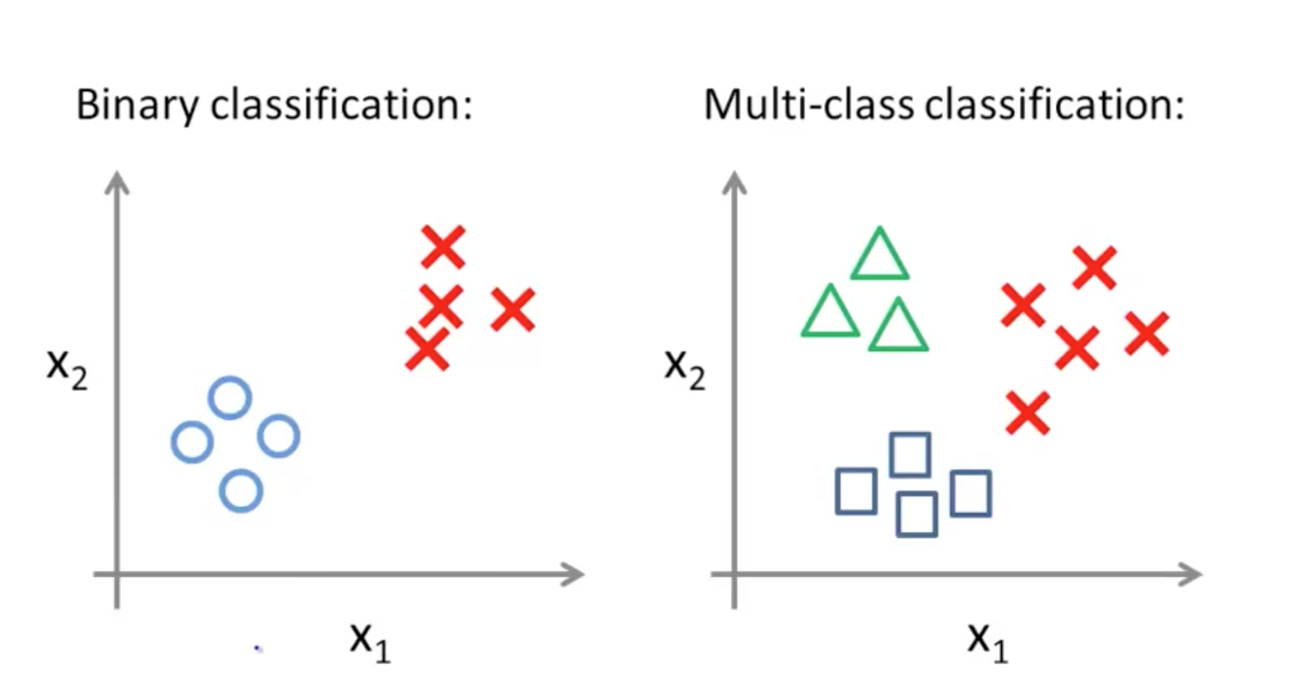

Slide 34
One versus all (one versus rest)
3 separate binary classification problem.
Create fake-training set with class-1 as class A and class-2 and class-3 (combined) as class B.
Train the standard logistic regression for binary classification problem : Class A v/s Class B. Let’s say the decision boundary is defined by h1
Repeat the same process with class-1 replaced by class-2 and class-3. Decision boundaries are h2 and h3 respectively
What this means : Train a logistic regression classifier h_{Θ}^{(i)}(x) for each class i to predict the probability that y=i.
On a new input x, for prediction pick the class i that maximizes h_{Θ}^{(i)}(x)

